Slide 1
Business and Industrial Economics
Prof. Luca Grilli
Antitrust I

Slide 2
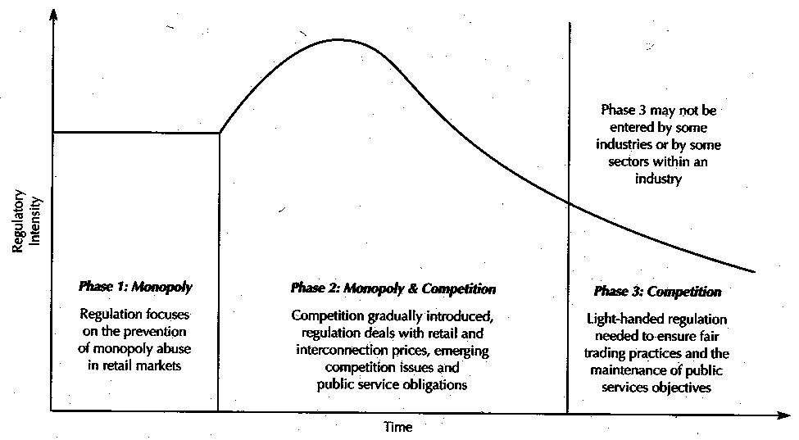
Regulation addendum (with some important implications for Antitrust at the end)
Regulation intensity path overtime
Phase 1: Monopoly vertically integrated
Regulation of final tariff so to limit market power of the only incumbent firm in the market
Phase 2: Opening to competition
Regulation is aimed at ensuring fair conditions of entry to new firms but still final tariffs are regulated so to avoid exploitation of market power by the incumbent ex-monopolist which is now a dominant player in a market where competition is still at its infancy stage
Phase 3: Access
Regulation focus is on ensuring that firms are not discriminated in accessing essential facilities still considered natural monopolies

Slide 3
European Digital Market Act (2023)
https://commission.europa.eu/strategy-and-policy/priorities-2019-2024/europe-fit-digital-age/digital-markets-act-ensuring-fair-and-open-digital-markets_en

Slide 4
Public Policy towards business
Industrial Policy
Competition policy
Regulation
Antitrust

Slide 5
Antitrust areas
Agreements between companies that restrict competition (Art. 85 EU Treaty of Rome, 1958 [~Art. 101 TFEU, 2007]; US Sherman act 1890)
Cartels or other unfair arrangements in which companies agree to avoid competing with each other and try to set their own rules.
Anticompetitive practices: Cartels (Collusion)
Abuse of a dominant position (Art. 86 EU Treaty of Rome, 1958 [~Art. 102 TFEU, 2007]; Sherman act 1890)
A major player tries to squeeze competitors out of the market: Predatory pricing
Mergers & Acquisitions (Art. Clayton act 1914; EU Council Regulation (EEC) No 4064/89 of 21 December 1989)

Slide 6
COLLUSION
STRATEGIC VARIABLE: Quantity
p = a – b(q1 + q2)
Π1 = pq1 – cq1 = [a – b(q1+q2)]q1 – cq1
Π2 = pq2 – cq2 = [a – b(q1+q2)]q2 – cq2
dΠ1/dq1 = a – 2bq1 – bq2 – c = 0 q1* = [(a – c) /2b] – (1/2)q2*
dΠ2/dq2 = a – 2bq2 – bq1 – c = 0 q2* = [(a – c) /2b] – (1/2)q1*
Cournot example
q1
q2(q1)
q1* = q2*
(1/2) Π^{M} > Π1 (Π2)
Collusion
q1(q2)
q2
Collusion

Slide 7
Premise
Remember Rohlfs’s words (Lecture on “Network economics 4”):
Rohlfs, 2003, Bandwagon effects in high-technology industries, p. 45: [in the case firms choose NO COMP, the most rationale strategy] “may be to signal an irrational commitment to win the race (of the standard) at all costs. This is analogous to a well-known result of oligopoly theory; namely, the most rational strategy for an oligopolist may be to signal an irrational strategy commitment to punish price cutters-regardless of the ruinous cost that it may incur by doing so.”

Slide 8
COLLUSION
Sustainability
1) n° of (identical/similar) firms
2) probability that no external factor will occur to change the game (e.g. entry of new firms, obsolescence of the focal product).
3) frequency of interactions between firms (i.e. the number of times firms play the same game)

Slide 9
1. N° of firms
Source: Massimo Motta, Competition Policy: Theory and Practice, 2003, ch. 4, p. 7

Slide 10
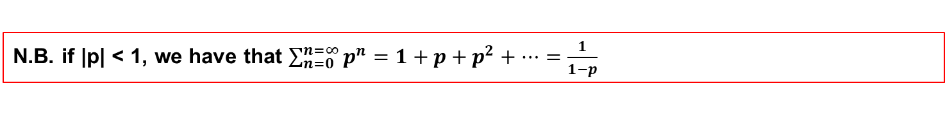
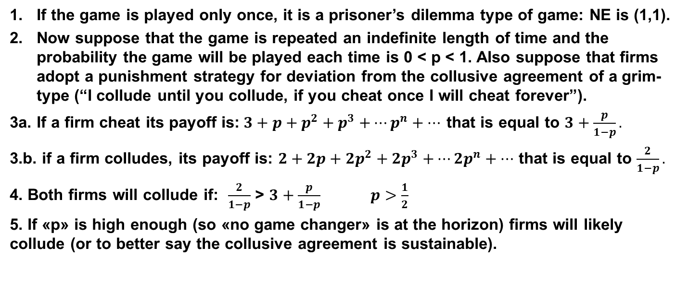
2-3. Repeated interactions and no game changer
1/2 | Cheat | Collude
Cheat | (1,1) | (3,0)
Collude | (0,3) | (2,2)
If the game is played only once, it is a prisoner’s dilemma type of game: NE is (1,1).
Now suppose that the game is repeated an indefinite length of time and the probability the game will be played each time is 0 < p < 1. Also suppose that firms adopt a punishment strategy for deviation from the collusive agreement of a grim-type (“I collude until you collude, if you cheat once I will cheat forever”).
3a. If a firm cheat its payoff is:$3+p+p^{2}{+ p}^{3}+…p^{n}+…$ that is equal to $3+\frac{p}{1−p}.$
3.b. if a firm colludes, its payoff is: $2+2p+{2p}^{2}{+ 2p}^{3}+…{2p}^{n}+…$ that is equal to $\frac{2}{1−p}.$
4. Both firms will collude if: $\frac{2}{1−p}$ > $3+\frac{p}{1−p}$ $p>\frac{1}{2}$
5. If «p» is high enough (so «no game changer» is at the horizon) firms will likely collude (or to better say the collusive agreement is sustainable).
N.B. if |p| < 1, we have that $\sum_{n=0}^{n=∞}{p^{n}=1+p+p^{2}+…=\frac{1}{1−p}}$

Slide 11
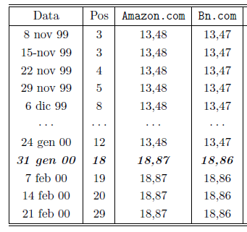
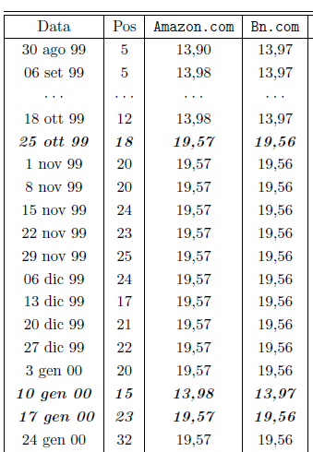
«Digital» increases frequency of interactions and, in doing so, enhance «collusion» possibilities
Latcovich & Smith 2001 “Pricing, sunk costs, and market structure on-line: evidence from book retailing” Oxford Review of Econ. Pol.
This temporal dynamics of a market can reveal that “big players” are colluding……..Why????

Slide 12
Rotemberg and Saloner 1986, “A supergame-theoretic model of price wars during booms”, American Economic Review, 76, pp. 390-407
INTUITION:
Firms collude on price.
In periods of:
High demand High incentive to deviate from the cartel (i.e. higher profits at the expense of the other firms) collusive price has to be reduced in order to reduce the incentive to deviate and make sustainable the cartel.
Low demand Low incentive to deviate from the cartel (i.e. lower profits at the expense of the other firms) collusive price can be raised since incentive to deviate is low and the cartel is still sustainable.

Slide 13

Tacit vs. Explicit collusion

Slide 14
Premise: Dominant position is never punished if not artificial (see slide on drastic vs. non drastic innovation)
Suppose that demand is given by: P = 120 – Q and all firms have constant marginal cost of c = $80
Let one firm have innovation that lowers cost to c_{M} = $20
This is a Drastic innovation. Why?
Marginal Revenue curve for monopolist is: MR = 120 – 2Q
If c_{M} = $20, optimal monopoly output is: Q_{M} = 50 and P_{M} = $70
Innovator can charge optimal monopoly price ($70) and still undercut rivals whose unit cost is $80
Should the innovator being blocked because it will turn out into a monopolist?
Ex-post allocative inefficiency but not ex-ante: p now is 70$ and not 80$, 50 units traded rather than 40.
Dynamic efficiency
(a new technique available)
Ex-post productive efficiency gain: now producing 1 unit costs 20$ rather than 80$

Slide 15
Abuse of a dominant position: predatory pricing
A major player tries to squeeze competitors out of the market: Predatory pricing
Is there a dominant position?
It depends on the definition of a relevant market
What is the “relevant” market? (EU Commission definitions)
(a) A relevant product market comprises all those products and/or services which are regarded as interchangeable or substitutable by the consumer by reason of the products' characteristics, their prices and their intended use.
(b) A relevant geographic market comprises the area in which the firms concerned are involved in the supply of products or services and in which the conditions of competition are sufficiently homogeneous.

Slide 16
Relevant market
It deals with:
Demand side substitutability (customers)
Supply side substitutability (suppliers)
Practical determination is far from obvious and quite complicated (e.g. survey data collection, analysis, econometrics, etc.). Several methods and techniques, all not-immune from critiques and problems.
Small but significant non-transitory increase in price (SSNIP test)
- Start with smallest possible market and ask if 5% price increase would be profitable for a hypothetical monopolist (market for bananas or market of concrete in the area x).
- if not, then firm does not have sufficient market power to raise price.
- Next closest substitute is added to the relevant market and test repeated keeping constant the price for the closest substitute (market for bananas & kiwi or market for concrete in x&y).
- Process continues until the point is reached where a hypothetical monopolist could profitably impose a 5% price increase keeping constant the price for all the closest substitutes (fruit market or market for concrete in x&y&z).
- Market then defined (fruit market/ market for concrete in x&y&z).
Cellophane fallacy: generally the “prevailing” price is the starting point to apply the SSNIP test, but this is not necessarily a competitive one. If it is already the one of monopoly (i.e. the optimal solution for the monopolist), a 5% increase by definition is not profitable, [the monopolist optimally sets a price in correspondence of an elastic part of the demand curve (remember the mark-up formula)]. In this case “an increase in the current level of prices might induce customers to switch to other products that would not necessarily be substitutes under competitive conditions (e.g. lower quality products)” (Willis 2005, Introduction to EU Competition Law, p. 28).

Slide 17
Abuse of a dominant position: predatory pricing
Is there a dominant position?
Once “relevant market” defined
What in practice constitute dominance?
Market share (generally above 40% in EU; 50% in US)
Length in time of that market share
(c) Differences in market shares with second competitors (high Herfindahl index)

Slide 18
Abuse of a dominant position: predatory pricing
Is there an abuse of a dominant position?
What is an abuse? The company exploits this position to eliminate competition
How in practice? Examples
depriving smaller competitors of customers by selling at artificially low prices they can't compete with (Predatory pricing)
(b) obstructing competitors in the market (or in another related market) by forcing consumers to buy a product which is artificially related to a more popular, in-demand product
(c) refusing to deal with certain customers or offering special discounts to customers who buy all or most of their supplies from the dominant company
[see art. 86 of Treaty of Rome, for a complete list]

Slide 19
What makes a price a predatory price?
1) Areeda-Turner (1975)
2) Recoupment loss (Ordover and Willig 1981)
3) Predatory intent (proofs of that)
Note: Generally for US are all necessary conditions, while in EU 1) might just be sufficient

Slide 20
Abuse of a dominant position: predatory pricing
Looking at social (in particular consumer) welfare maximization that should represent the aim of Antitrust, all this process turns out to be really problematic once put into practice. WHY?
Think to “predatory pricing”: price down is the only sure thing of the whole process
Different views and different implementation methods about Antitrust policy

Slide 21
The Chicago Law and Economics School (vs. The New Brandeis Movement)
The Harvard antitrust school (Bain and the S-C-P paradigm, See JOE S. BAIN, INDUSTRIAL ORGANIZATION (2d ed. 1959) which we may consider the standard one (originated after the world war II).
The Chicago antitrust school (MCGEE J.S. 1958, “Predatory price cutting: the Standard Oil (N.J.) case”, Journal of Law and Economics, 1,137-169; BORK R.H. 1978, The Antitrust Paradox. A Policy at War with Itself, Free Press, New York; POSNER R., Economic Analysis of the Law, 2007, Aspen Publishers, these are only few most emblematic examples, among others possible) which has culturally led the debate in the recent past (especially in the US).
Excessive antitrust interventionism may end up harming rather than benefiting social (and in particular consumer) welfare.
But please note that New Brandeis Movement that basically states the opposite and has an explicit “antimonopoly” position (see 2 articles by Lina Khan: “Amazon’s Antitrust Paradox”, 2017, The Yale Law Journal, vol. 126(3); and in particular, “The New Brandeis Movement: America’s Antimonopoly Debate”, Journal of European Competition Law & Practice, 2018, Vol. 9, No. 3) is gaining momentum (“The drumbeat is getting louder” quoting the above underlined article), especially after Biden appointed Lina Khan as president of the FTC and Jonathan Kanter as head of the Antitrust Division of the DoJ in the US in 2021.
In the last two years (2023-2024), the US has started/refiled Antitrust cases vs. Apple, Amazon and Google.

Slide 22
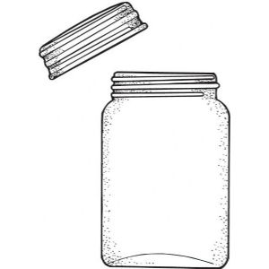
The Chicago Law and Economics School
Over time, the Chicago School has built a theoretically sounded framework aimed at diminishing the relevance of antitrust interventions.
See for example the “single monopoly” theory (Bork, 1978) to illustrate how monopolists do not have interest for monopolizing adjacent markets, since there’s the possibility of only “one monopoly profit”.
Homogenous consumers: each one has wtp = 10 for jars & lids.
Cost for producing a jar = 3
Cost for producing a lid = 3.
If a firm is a monopolist in the “jars & lids” market: Best unit profit = 4
If the two markets are separated, and jars offered at a competitive price (equal to cost, so price of jar = 3), the remaining wtp of consumers for lid is equal to 7, thus again the maximum unit profit is = 4.
No interest for the lid monopolist to monopolize even jars, because profits will remain the same.
[The theory is valid, only under very specific assumptions, e.g. goods are consumed at fixed proportions, homogenous preferences, etc.].

Slide 23
Example on predatory pricing
1) Predatory Pricing is very unlikely:
It is extremely expensive (price reduction may also mean higher output to produce at very high costs, if MC curve is increasing).
Acquisition can be a much less expensive way to eliminate a competitor.
If the prey exit easily, this means that some others could also easily enter into the market
2) Firms may refrain from pricing aggressively so to avoid any risk of being accused of predation (MC has to be estimated and one never knows how things turn out in legal courts).

Slide 24

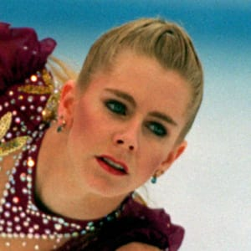
Strategic use by inefficient competitors of antitrust infringement claims of efficient firms in a “Tonya Harding-style competition” (Evans, 2009, The Middle Way on Applying Antitrust to Information Technology).

Slide 25
Different implementation methods
Rule of reason vs. Rule of law
[“per se” violations]
Problem of RoR: subjectivity, lack of transparency, little predictability to market players
Problem of RoL (per se): risk of wrong decision in terms of welfare

Slide 26
Rule of reason vs. Rule of law (evolution)
US & EU
Historically
EU integration process
Chicago School
EU
EU
US
US
Rule of reasons
Rule of Law
Globalization
But nowadays the influence of the neo-Brandeisians pushes US (again) much more towards RoL
US
EU
In the very recent past
RoR
RoL

Slide 27
References
https://ec.europa.eu/competition-policy/index_en
Further reading:
Cabral, Introduction to Industrial Organization, 2000, I edition, chapters 8 and 15.2, 15.3 [2018, II edition, chapter 9, 11 and 12.3] .
Besanko et al., The Economics of Strategy, chapter 5, pp. 166-167 (SSNIP test)

